Slide 1

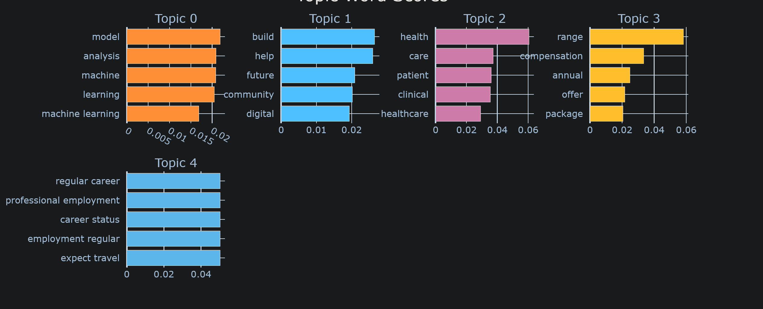
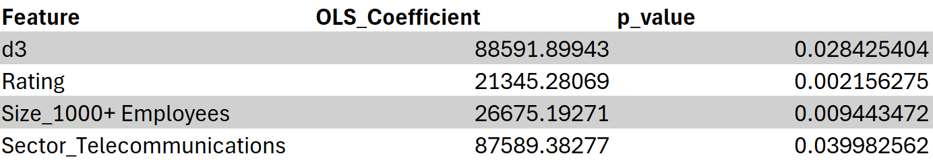
Identifying Thematic Trends in Data Science Job Descriptions using BERTopic
Denley Tran
Advisor: Weijie Pang (Ph.D), Ying Wang (Ph.D)
School of Computing and Data Science, Wentworth Institute of Technology
Introduction
Datasets
Results
Results
Job descriptions contain rich signals about the evolving demands of data science work and expectations that shape modern data science roles. Uncovering these themes provides valuable insight into employer priorities and the broader market landscape.
To better understand the thematic content and hidden trends within a Data Science job posting, we applied BERTopic, a transformer-based topic modeling method, to extract and interpret dominant themes.
The dataset comprises 1,500 data science job postings scraped from Glassdoor on September 18th, 2023.
Key fields include company rating, size, location, and salary estimate.
To prepare the data for analysis, we cleaned and preprocessed the dataset by filtering out irrelevant or incomplete entries (such as postings without descriptions or duplicates) and transforming key variables.
After pre-processing, the final sample used for analysis was reduced to 652 listings.
The results reveal five key topics:
Topic [0] core machine learning and analytical skills: highlighting the technical expertise central to the role;
Topic [1] role narrative from the employer perspective: representing the employer’s view of the role as contributing to digital transformation and advancing company growth and community-focused objectives;
Topic [2] healthcare and clinically relevant applications: a cluster of postings where data-science methods are applied in medical or clinical contexts. The presence of these terms may indicate a growing trend/demand for healthcare-focused data-science roles. (e.g., data scientists who can work with patient-level datasets, clinical workflows, and health-related analytics
Topic [3] compensation and benefits: reflects standardized language in job posting to communicate salary ranges and employment packages;
Topic [4] employment condition and career expectations: This topic centers on formal employment expectation to the posted role.
Linear regression displayed the four most prominent features as well as their p-values:
Conclusions
Our analysis demonstrates how BERTopic can be used to summarize and interpret complex job postings, offering actionable insights for job seekers, recruiters, and curriculum designers.
Methodology
Results
Data Preprocessing
We used a dataset of Data Science job listings in 2023 scraped from multiple job boards on Kaggle.
Following the preprocessing steps described in the dataset section, the final dataset consists of 652 unique job postings.”
Analysis - Topic Modeling with BERTopic
Applied BERTopic, a transformer-based topic modeling method, to extract latent themes from job descriptions.
BERTopic uses embeddings and clustering to extract coherent topics from text.
Transformer-based embeddings capture semantic relationships, may producing more meaningful topics than traditional methods.
Implementation
Data processing and analysis was conducted in Python using Pandas for cleaning, BERTopic for topic modeling and Matplotlib for visualization.
Descriptive overview of the study sample (N = 652 job postings)
Acknowledgements
Characteristics | category | N | %
Company rating | 1 | 3 | 0.46%
 | 2 | 27 | 4.15%
 | 3 | 302 | 46.39%
 | 4 | 252 | 38.71%
 | 5 | 22 | 3.38%
 | Unknown | 45 | 6.91%
company size | 1000+ | 382 | 58.68%
 | 1-200 | 134 | 20.58%
 | 200-1000 | 81 | 12.44%
 | Unknown | 54 | 8.29%
Company type | Company - Private | 259 | 39.78%
 | Company - Public | 251 | 38.56%
 | Nonprofit Organization | 37 | 5.68%
 | Subsidiary or Business Segment | 26 | 3.99%
 | Government | 21 | 3.23%
 | Unknown | 18 | 2.76%
 | College / University | 17 | 2.61%
 | Others | 22 | 3.37%
sector | Information Technology | 186 | 28.57%
 | Unknown | 64 | 9.83%
 | Manufacturing | 43 | 6.61%
 | Financial Services | 42 | 6.45%
 | Management & Consulting | 40 | 6.14%
 | Retail & Wholesale | 35 | 5.38%
 | Pharmaceutical & Biotechnology | 32 | 4.92%
 | Aerospace & Defense | 32 | 4.92%
 | Healthcare | 32 | 4.92%
 | Other | 145 | 22.26%
Professors Pang and Wang: Supervisors of the project
Bibliography
Hill, Alessandro, Kalen Goo, and Puneet Agarwal. "Recommending the right academic programs: an interest mining approach using BERTopic." Data Mining and Knowledge Discovery 39.3 (2025): 1-40.
Khodeir, Nabila, and Fatma Elghannam. "Efficient topic identification for urgent MOOC Forum posts using BERTopic and traditional topic modeling techniques." Education and Information Technologies 30.5 (2025): 5501-5527.

